Slide 1
STOCK ANALYSIS AND PORTFOLIO MANAGEMENT
Harmeet Singh
Sheikh Faizal Ali
Sagar Prakash Kulkarni

Slide 2
Objective
Objectives:
Explore the stock prices based on trend, correlation between the stocks
Evaluate the stocks based on Capital Asset Pricing Metrics
Suggest investment strategy for the client(i.e Alexa) to achieve her financial goal of getting good but stable returns to fund her NGO
Data Available:
Data of 12 stocks in the US market and the index SP500
The stocks are from Aviation, Healthcare, Finance and Technology industries.
Three stocks from each of these industries

Slide 3
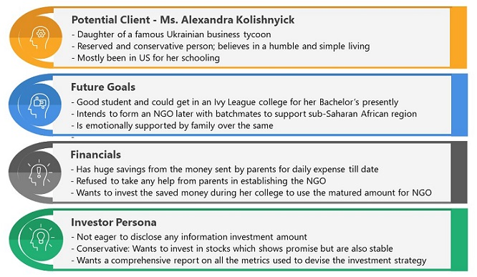
Investor Understanding

Slide 4
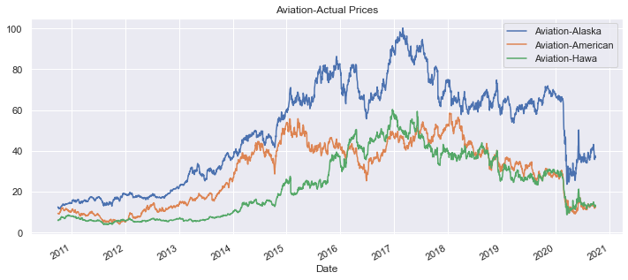
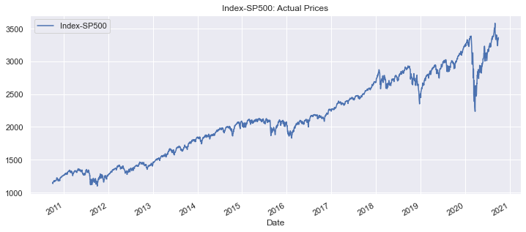
Price Trend - Actual Prices(Aviation)
All three aviation stocks showed an upward trend until 2017-18.
From 2017-18 to March 2020, the stock prices fluctuated.
A sharp decline in prices was observed in March 2020.
This drop may be attributed to the COVID-19 outbreak, which significantly impacted the revenues and profits of all companies in the aviation industry.
The decline was especially steep for Alaska Airlines.
After March, a slight but positive trend emerged in all stock prices.
There has been notable price variation.
Since March 2020, the stocks have moved in sync with the S&P 500 index.

Slide 5
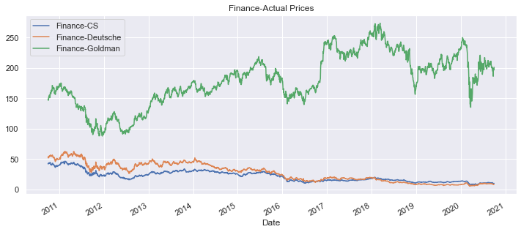
Price Trend - Actual Prices(Finance)
There is a notable difference in price levels between Goldman Sachs and the other two stocks.
Credit Suisse and Deutsche Bank exhibit a clear negative trend, while Goldman Sachs shows a bumpy but generally positive trend.
A sharp decline in prices was observed in March 2020. This may be attributed to the COVID-19 outbreak, which adversely affected the financial performance of all companies in the aviation industry.
After March, Goldman Sachs began to recover in line with the index, though it has not yet returned to pre-COVID levels.

Slide 6
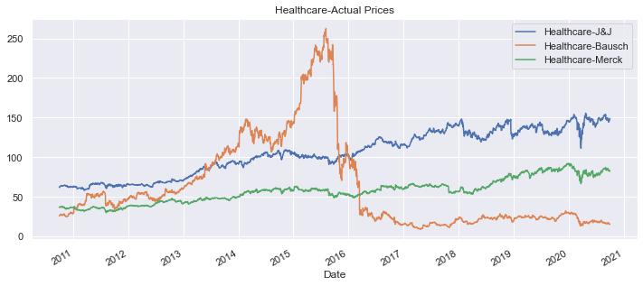
Price Trend - Actual Prices(Healthcare)
Bausch began with a low valuation, peaked in mid-2015, and then experienced a sharp decline through 2016 due to allegations of inappropriate accounting practices. The company's significant debt burden further exacerbated its challenges.
Johnson & Johnson and Merck have shown steady growth.
J&J quickly recovered after the COVID-19 outbreak, followed by Merck, while Bausch has yet to bounce back.

Slide 7
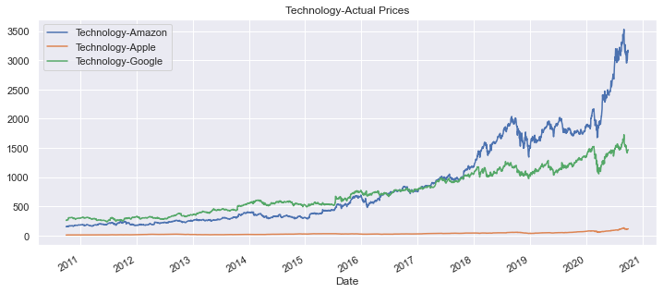
Price Trend - Actual Prices(Technology)
Amazon’s growth has been phenomenal, while Apple has shown steady progress.
All three stocks display a clear upward trend, with Amazon being the most in demand.
Google initially led in price but, since 2018, has fallen below Amazon.
Price levels vary significantly among these stocks, with Apple priced the lowest, leading to higher trading volumes than Google.

Slide 8
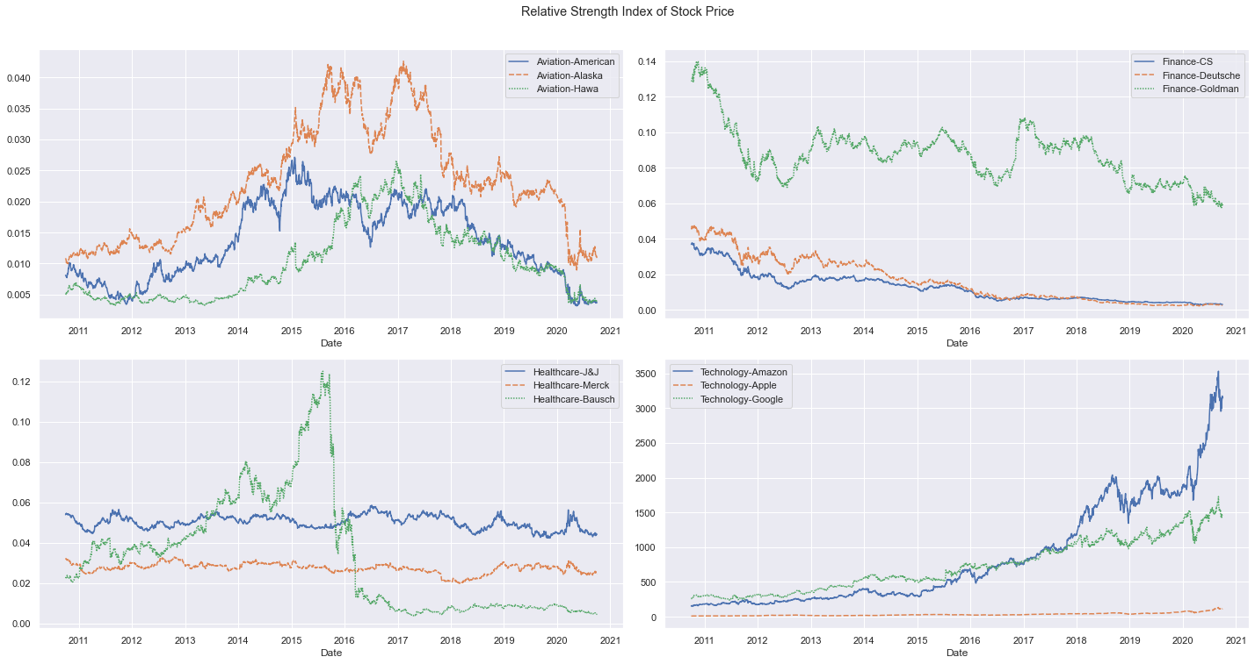
Relative Strength Index of Stock Prices
The Relative Strength Index supports these findings, showing that Technology is the only sector in an uptrend, despite notable differences in price levels.
In Healthcare, Johnson&Johnson and Bausch closely follow the index’s movement.
Stocks in the Finance and Healthcare sectors are generally in a downtrend.

Slide 9
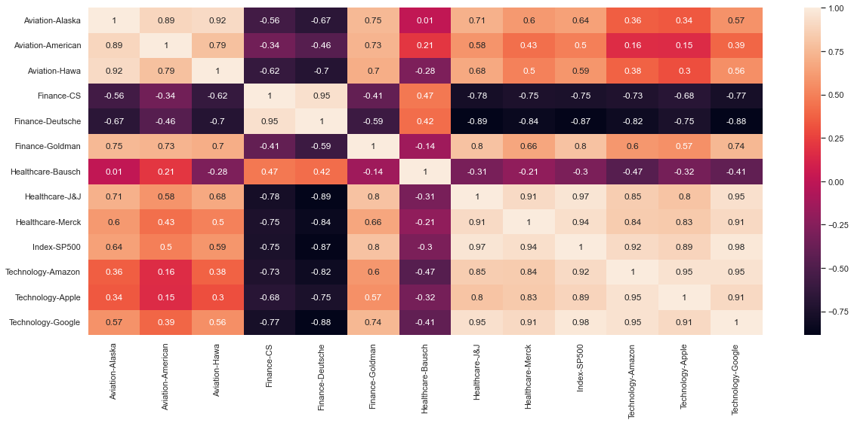
Correlation Between Price and S&P 500
Strong Positive Correlation (0.6 to 1): Apple, Amazon, Google, Goldman Sachs, Johnson & Johnson, Merck & Co., and Alaska Airlines.
Weak Positive Correlation (0 to 0.6): American Airlines, Hawaiian Holdings.
Negative Correlation (0 to -1): Bausch Health, Credit Suisse, Deutsche Bank.

Slide 10
CAPM - Metrics Used for Selection of Stocks
1. Annualized Return
2. Cumulative Return
3. Annualized Risk
4. Sharpe Ratio
5. Beta
6. Expected Return

Slide 11
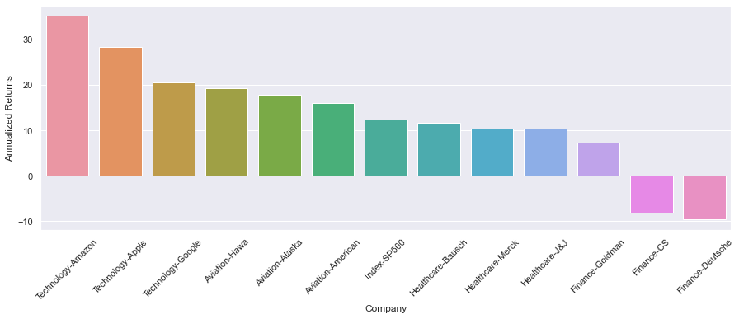
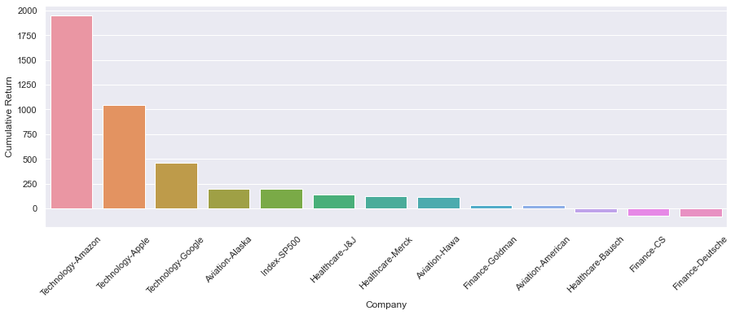
CAPM - Annualized Returns
Credit Suisse and Deutsche Bank display negative annualized and cumulative returns, making them candidates for exclusion.
Technology stocks lead with the highest annualized and cumulative returns.

Slide 12
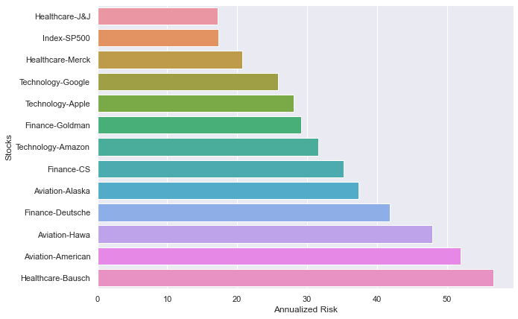
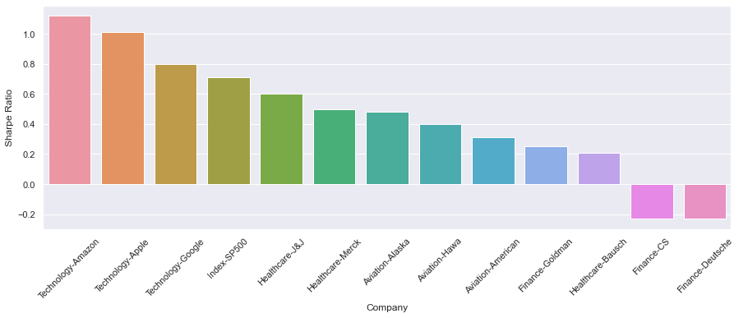
CAPM - Annualized Risk And Sharpe Ratio
The Sharpe Ratio combines risk and return, with a higher ratio indicating a better stock.
Stocks with a Sharpe Ratio exceeding that of the S&P 500 include Amazon, Apple, and Google, making them suitable for the final portfolio, while others can be excluded.

Slide 13
CAPM - Results
S.No | Stocks | Annualized Returns | Cumulative Return | Annualized Risk | Sharpe Ratio | Beta | Expected Return
0 | Index-SP500 | 12.29 | 193.39 | 17.36 | 0.71 | 1 | 12.29
1 | Aviation-Alaska | 17.87 | 194.28 | 37.4 | 0.48 | 1.23 | 14.96
2 | Aviation-American | 16.03 | 32.29 | 51.95 | 0.31 | 1.35 | 16.37
3 | Aviation-Hawa | 19.29 | 116.28 | 47.86 | 0.4 | 1.23 | 14.99
4 | Finance-CS | -8.19 | -76.39 | 35.25 | -0.23 | 1.37 | 16.56
5 | Finance-Deutsche | -9.62 | -84.03 | 41.87 | -0.23 | 1.54 | 18.49
6 | Finance-Goldman | 7.32 | 36.07 | 29.1 | 0.25 | 1.30 | 15.77
7 | Healthcare-Bausch | 11.71 | -39.65 | 56.67 | 0.21 | 1.32 | 15.94
8 | Healthcare-J&J | 10.3 | 141.1 | 17.22 | 0.6 | 0.66 | 8.39
9 | Healthcare-Merck | 10.34 | 126.64 | 20.72 | 0.5 | 0.73 | 9.21
10 | Technology-Amazon | 35.22 | 1948.49 | 31.57 | 1.12 | 1.00 | 12.28
11 | Technology-Apple | 28.4 | 1047.77 | 28.13 | 1.01 | 1.06 | 13.02
12 | Technology-Google | 20.6 | 461.28 | 25.86 | 0.8 | 1.01 | 12.44

Slide 14
Results of Analysis of Recommended Stocks(1-10-2010 to 30-09-2020)
Stocks | Annualized Returns | Annualized Risk | Stock Cumulative Return | Invested Amount | Stock Value
Amazon | 35.22 | 31.57 | 1948.49 | 166667 | 3414150
Apple | 28.40 | 28.13 | 1047.77 | 166667 | 1912950
Google | 20.60 | 25.86 | 461.28 | 166667 | 935466
Invested Fund : 500,000 USD
Investment Period : 10 Years
Matured Amount : 6.2 Million USD
Annual ROI Portfolio : 29%
Annualized Risk : 28.52%

Slide 15
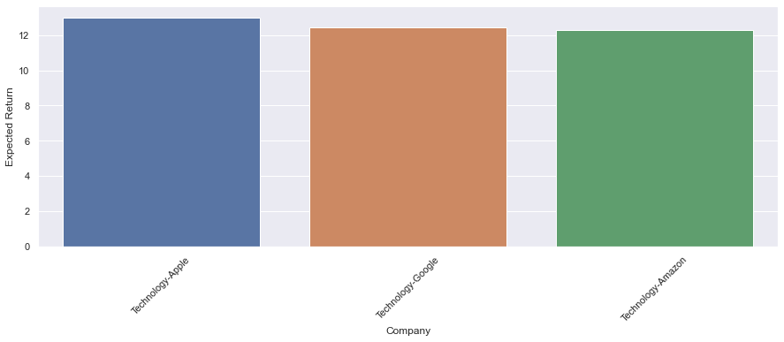

Recommended Stocks - Volatility And Expected Returns
Beta
Expected Returns
Recommended Stocks | Beta | Expected Return
Amazon | 0.99 | 12.27
Apple | 1.06 | 13.02
Google | 1.01 | 12.44
The volatility of all tech stocks is relatively stable and aligns closely with the S&P 500 index.
All tech stocks provide expected returns equal to or exceeding those of the S&P 500 index.
Given their balanced volatility and strong expected returns, tech stocks are suitable candidates for inclusion in the portfolio.

Slide 16
Thank You

